Slide 2
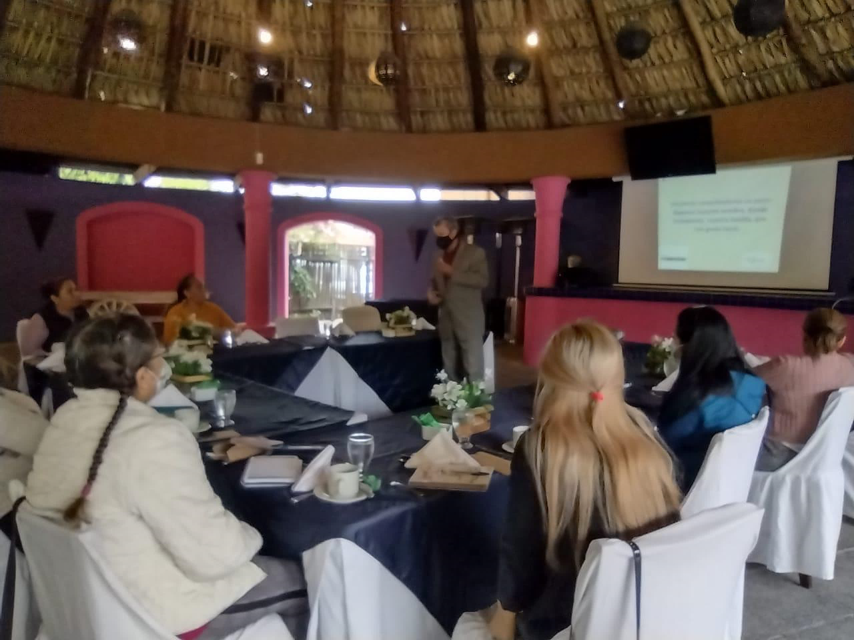
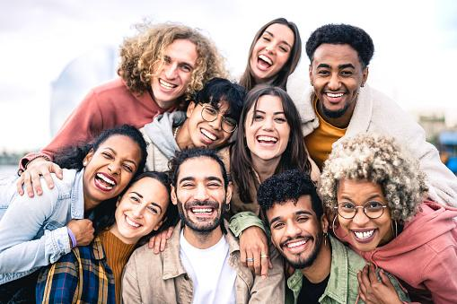
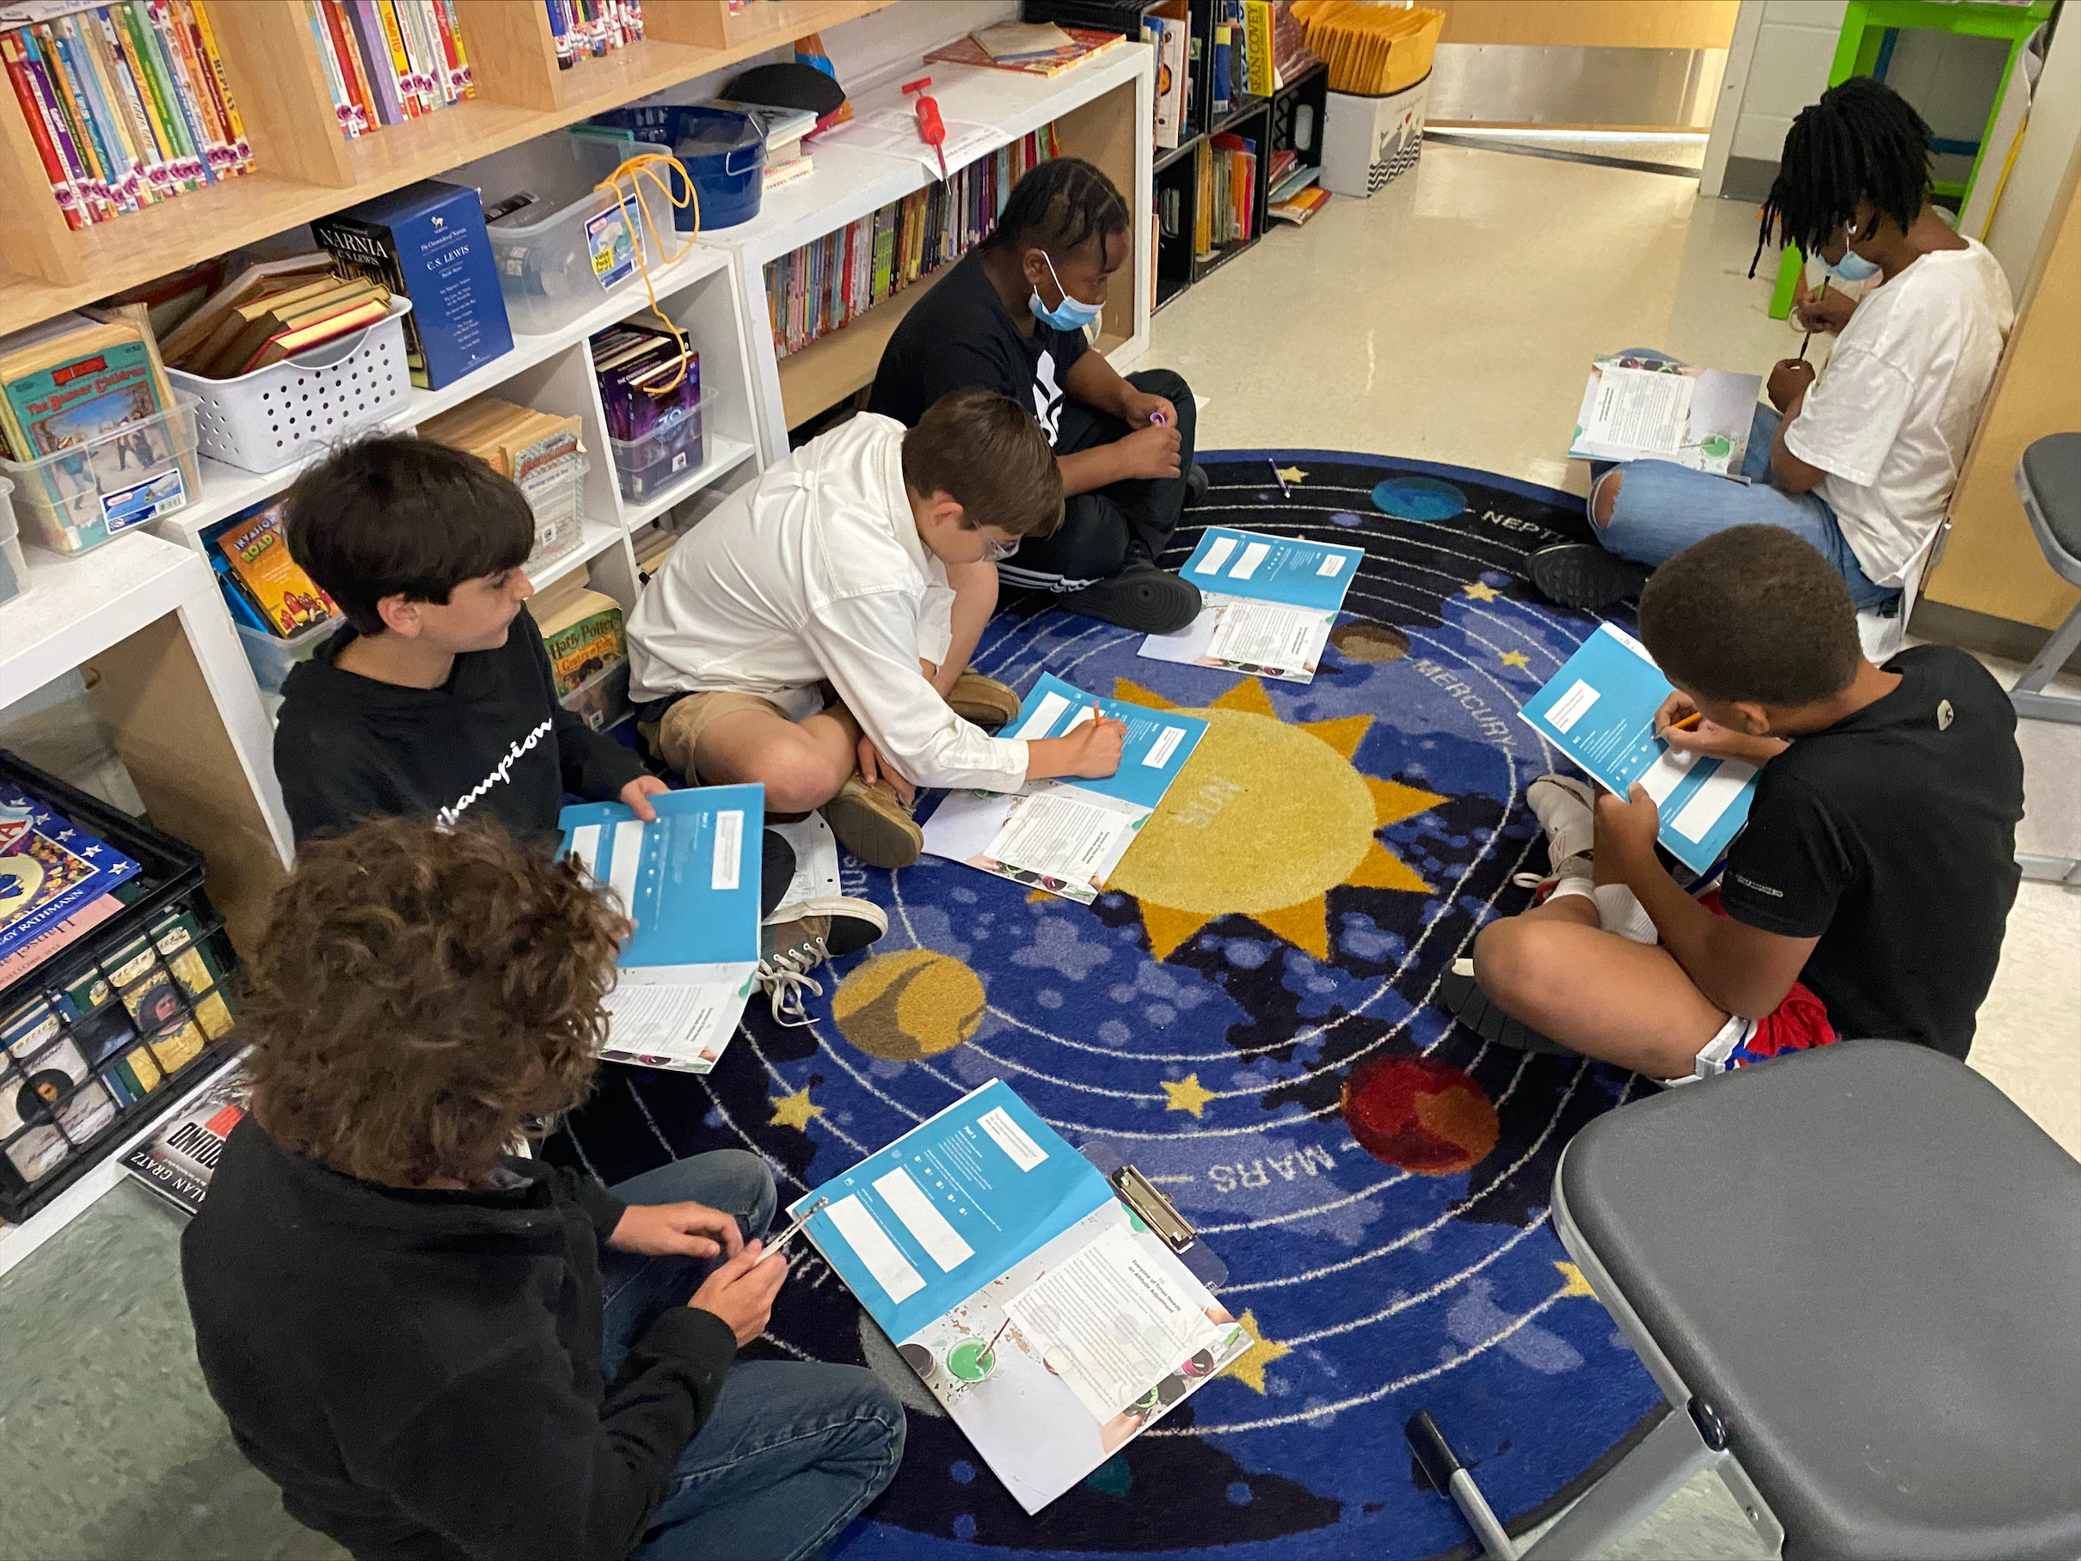
Growing leaders who create powerful positive change
Country
Community
Children

Slide 3
Youth
Adults
Notes:
CYW for adults
iLead for students
What we hear when we listen to the challenges in education, we hear a cry for connection. Due to the circumstances our world has presented in the past decade, relationships and values have taken a back seat to other demands. From teachers, support staff all the way to superintendents – taking time to talk to one another, value one another, listen to one another hasn’t been a luxury anyone has made time for. And as a heart-driven profession, these statistics are telling of the lack of connection.
CYW and iLead offer connection. CYW and iLead offer reflection. CYW and iLead offer self-awareness. CYW and iLead offers opportunities to grow from the inside out.
It matters because these programs hit at the core of who we are– whole people trying to do the best in our world today. This isn’t your typical leadership development program. This program is transformational in all areas of an individual's life– from work, to home and everywhere in between.
As of TODAY 1.3 million people are actively engaged in transformation tables around the world. We would like to give you a little peek behind the curtain to a solution to assist in these areas.
We are in the business of adding value to other people.
Transformation starts with a table and values.
John C. Maxwell believes that leading one’s self well is the most challenging aspect of leadership. Developing soft skills like integrity, listening and valuing people is a great start to leadership development. But we offer a methodology that integrates six people sitting around a table, personal reflection and a weekly action step that increases the effectiveness.
The Transformation Tables methodology is incredibly successful in this regard because its very format sets the scene for a different type of opportunity for growth.
The Transformation Tables method
uses a peer-to-peer, small group design where everyone participates
calls for personal reflection that drives one small positive change each week,
meets weekly for one hour,
is facilitated rather than taught.
This format puts everyone on an equal ground.
Each person in the group is expected to participate. Their voice is wanted and needed to optimize the development experience. Instead of communication being one way, it is a group activitiy with reinforces the learning process.
Transformation Tables start with what we call “Values Table which includes six leadership lessons on the universal values of Hope, Listening, Valuing Every Person, Integrity, Forgiveness, and Multiplication.
Simply put, Transformation Tables have proven to change lives from the inside out and produce a ripple effect that can build toward powerful, positive change in your life!
We know that when people learn good values and live them out, they become more valuable—more valuable to their family, to their work, to their community and ultimately the world.

Slide 4
Texas iLead Content
1. Choices
2. Growth
3. Attitude
4. Commitment
5. Relationships
6. Character
7. Forgiveness
8. Self-Worth
9. Responsibility
10. Courage
11. Initiative
12. Priorities
13. Teachability
14. Self-Discipline
15. Resilience
16. Influence
iLead Values
Notes:
Tracy
These values are universal—values that we can all agree with and stand behind

Slide 5
Lesson Process
Action
Insight
Evaluation
Benefits
Discussion
Notes:
.

Slide 6
Becoming a Facilitator
Lead by example
Don’t coach or teach
Model respect
and encouragement
Make the action step measurable

Slide 7
INSTRUCTIONS
Go around the table take turns reading the lesson (underline what catches your attention)
1
Go around the table sharing the one thing that stood out the most to you from what you underlined
2
Take 5 minutes to let everyone write out their answers to the evaluation and action section
3
Go around the table and ask everyone to share their responses.

Slide 8
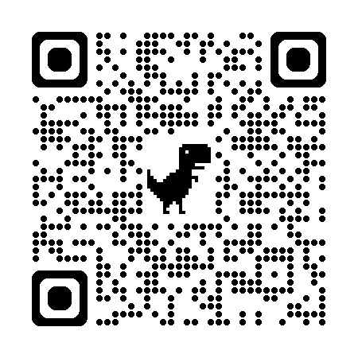
GET READY FOR
A TASTE OF TRANSFORMATION
SCAN THE CODE USING YOUR SMART PHONE CAMERA TO ACCESS THE LESSON
‹#›
Notes:
This QR code takes you to the Multiplication Lesson. Feel free to replace the QR code and edit the slide to fit the lesson you want to present.
Attitude Lesson Link:
https://drive.google.com/file/d/1ZLu7tXp3f8Wmqnf-3ThJUIUpB9UpIHNa/view?usp=sharing

Slide 9
Key Characteristics
Based on John’s proven leadership principles
Features a Peer-to-Peer Learning Model
Students get to PRACTICE leadership
Shifts workflow from educator to student
Free access to resources, support and minimal cost for consumable workbooks (Digital Access Free)
Notes:
Tracy

Slide 10
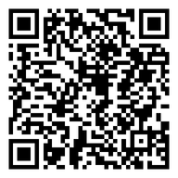
Leadership Development is back for 2024-2025!
October 1-Teachability
November 5-Humility
December 3-Generosity
January 7-Priorities
February 4-Valuing Every Person
March 4-Personal Growth
April 1-Adding Value
First Tuesday
Each Month 4:30 p.m. CST
Scan the QR code to Register for our upcoming Leadership Development Series! You won’t be sorry!
Notes:
Christine
https://us02web.zoom.us/meeting/register/tZcrd-mhrz0iE9fGoODW5Ciev-0WTfEiUs9k#/registration

